Slide 1
NLP - Miniproject
Document Clustering

Slide 2
Team
Aniket Bote (D17C-10)
Devashish Gopalani (D17C-20)
Ashish Gwalani (D17C-22)

Slide 3
Problem
We can define the goal in hard flat clustering as follows. Given (i) a set of documents D = {d1,...dn}, (ii) a desired number of clusters K, and (iii) an objective function that evaluates the quality of a clustering, we want to compute an assignment ⋎:D→ {1,...,K} that minimizes (or, in other cases, maximizes) the objective function. In most cases, we also demand that ⋎ is surjective, i.e., that none of the K clusters is empty.

Slide 4
Stakeholder
● Advertisers: These are marketing professionals who with the help of document clusters can analyse if people are more responsive to advertisements of documents of particular clusters.
● Company Personnel: Many MNCs use automatic document clustering system to cluster all the documentation generated during one fiscal year into respective clusters.

Slide 5
Methodology
Tokenizing and Stemming
Stopwords removal
Generating Vocab
Generating Tf-idf Matrix
Elbow Curve Method
Generate Results

Slide 6
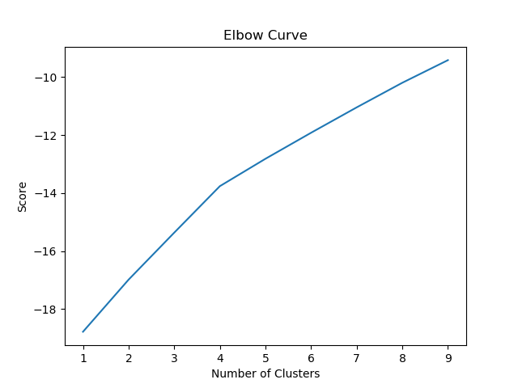
Elbow Curve

Slide 7
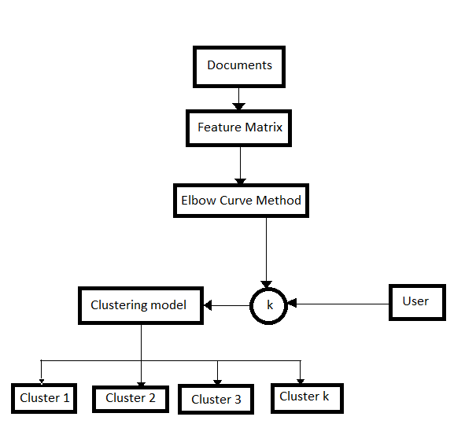
Conceptual Diagram

Slide 8
TECHNOLOGIES USED:
1. Python 3.6
2. NLTK
3. Scikit-Learn
4. Matplotlib
5. regex

Slide 9
Conclusion
Document clustering (or text clustering) is the application of cluster analysis to textual documents. It has applications in automatic document organization, topic extraction and fast information retrieval or filtering.

